Slide 1
Lecture 7: I/O Management, disk schedule and Drivers
Prof Yotov
CS6233
Slides by Prof Sandoval
Some slides derived from : William Stallings
Thanks !!

Slide 2
Drivers & I/O
Code for handling interactions with hardware peripherals makes up a significant portion of most OSes
Interacting with hardware is complicated and hard to get right
This is one reason we make OSes do it!
Another reason is that hardware is a shared resource we need to manage
Notes:
Peripherals 外部 设备

Slide 3
objectives

Slide 4
You will be able to
Summarize Categories of I/O Devices
Understand different I/O Techniques
Explain key issues in the design of OS support for I/O
Analyze performance implications of different I/O buffering techniques
Understand perf implications of disk cache
Describe I/O XV6
Notes:
Implications 启示
Perf 性能

Slide 5
i/o hardware

Slide 6
Categories of I/O Devices
External devices that engage in I/O with computer systems can be grouped into three categories:
Block Devices
Character Devices
Random access
Only support reading/writing streams
You can ask for any block of data with equal ease
Eg: Disk Drives, SSD, floppy, CD
Not structured into blocks
Example: Serial Port
Notes:
Everyone agrees that a disk is a block addressable device. It’s always possible to seek for another cylinder and then wait for the required block to rotate under the head.
But think about tapes? How about tapes? Are they also block addressable?
Stream of characters without regard to block structure. It is not addressable and and does not have seek.
engage in 参与
Addressable 寻址
Cylinder圆筒

Slide 7
Classification
Lots of stuff doesn't quite fit into that division
Clocks/timers
Graphics cards
But it's still a reasonably useful abstraction – many things can be put into one of the two, and we can write interfaces that deal generically with them

Slide 8
Differences in I/O Devices
Devices differ in a number of areas:
Data Rate
there may be differences of magnitude between the data transfer rates
Application
the use to which a device is put has an influence on the software
Complexity of Control
the effect on the operating system is filtered by the complexity of the I/O module that controls the device
Unit of Transfer
data may be transferred as a stream of bytes or characters or in larger blocks
Data Representation
different data encoding schemes are used by different devices
Error Conditions
the nature of errors, the way in which they are reported, their consequences, and the available range of responses differs from one device to another
Notes:
There are great differences across classes and even substantial大量的 differences
within each class. Among the key differences are the following:
• Data rate: There may be differences of several orders of magnitude between
the data transfer rates. Figure 11.1 gives some examples.
• Application: The use to which a device is put has an influence on the software
and policies in the operating system and supporting utilities. For example, a
disk used for files requires the support of file management software. A disk
used as a backing store for pages in a virtual memory scheme depends on the
use of virtual memory hardware and software. Furthermore, these applications
have an impact on disk scheduling algorithms (discussed later in this
chapter). As another example, a terminal may be used by an ordinary user or a
system administrator. These uses imply different privilege levels and perhaps
different priorities in the operating system.
• Complexity of control: A printer requires a relatively simple control interface.
A disk is much more complex. The effect of these differences on the operating
system is filtered to some extent by the complexity of the I/O module that
controls the device, as discussed in the next section.
Unit of transfer: Data may be transferred as a stream of bytes or characters
(e.g., terminal I/O) or in larger blocks (e.g., disk I/O).
• Data representation: Different data encoding schemes are used by different
devices, including differences in character code and parity conventions.
• Error conditions: The nature of errors, the way in which they are reported,
their consequences, and the available range of responses differ widely from
one device to another.
This diversity makes a uniform and consistent approach to I/O, both from the
point of view of the operating system and from the point of view of user processes,
difficult to achieve.

Slide 9
Source: Stallings, 8th edition. Chapter 11.
Notes:
There may be differences of several orders of magnitude between the data transfer rates.
Figure 11.1 gives some examples.
Optical disk 光盘

Slide 10
Device Controllers
Hardware peripherals tend to have both mechanical and electronic component (the device controller)
OS communicates with electronic component, which actually controls the mechanical bits

Slide 11
Whats the difference between device controller and device driver?
Device Drivers : low level programs written by hardware manufacturers which are loaded as kernel modules and provide the kernel with the knowledge on how to control the devices
Device Controllers: A device controller (hardware) understands "software" input. It translates software input into something a hardware device understands. Controllers sometimes have their own memory and their own CPU.
Device drivers are purely software, no matter where they are found. Device drivers communicate between the operating system and the physical device controller.
Source: quora

Slide 12
Device Controllers
What does the electronic component do?
Provides a higher level interface to the actual mechanical operation of the device
Perform error correction on the low-level data retrieved before handing it back to the OS
Implement processing algorithms (such as DSP) in hardware, faster than the main CPU could

Slide 13
Firmware
The device controllers also run software and have their own operating systems (firmware)
It turns out that this is often upgradeable by the user (to fix bugs)
This is not always a good thing

Slide 14
Hard Drive Backdoors
By changing the software running on your hard drive, an attacker could:
Hide files from the main OS
Re-infect a computer even after wiping & reinstalling the hard drive
There is evidence that the NSA has been using this technique

Slide 15

How are the types of I/O Devices classified?
What is a device controller?
Notes:
Block devices and Character devices

Slide 16
i/o techniques
Techniques for performing I/O are:
Port I/O
Memory Mapped I/O
Interrupt-driven I/O
Direct Memory Access (DMA)
Notes:
Appendix C summarizes three techniques for performing I/O:
• Programmed I/O : The processor issues an I/O command, on behalf of a process,
to an I/O module; that process then busy waits for the operation to be completed
before proceeding.
• Interrupt-driven I/O : The processor issues an I/O command on behalf of
a process. There are then two possibilities. If the I/O instruction from the
process is nonblocking, then the processor continues to execute instructions
from the process that issued the I/O command. If the I/O instruction
is blocking, then the next instruction that the processor executes is from
the OS, which will put the current process in a blocked state and schedule
another process.
• Direct memory access (DMA) : A DMA module controls the exchange of data
between main memory and an I/O module. The processor sends a request for
the transfer of a block of data to the DMA module and is interrupted only
after the entire block has been transferred.

Slide 17
Port I/O
There are a fixed number of port addresses
Specialized CPU instructions (in and out) read and write bytes to these ports, which are connected to hardware devices:
IN REG, PORT
OUT PORT, REG
Can be thought of as having a separate address space just for I/O
Used by IBM 360 and successors

Slide 18
Memory Mapped I/O
Contrast to port I/O: only one big address space
Certain portions of physical memory are assigned to various hardware devices
Reading from / writing to that address has the effect of receiving / sending data to the peripheral
Introduced with the PDP 11 used by x86

Slide 19
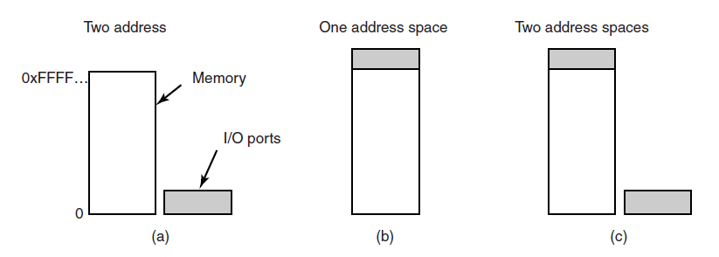
Port I/O
Memory Mapped I/O
Hybrid

Slide 20
Port I/O vs MMIO
Port I/O
Need to have extra CPU instructions
Not generally accessible from C/C++ code (must use assembly)
Memory mapped I/O
Sacrifice some physical address space
Can interact badly with memory caching
Each address must be checked to see if it is I/O

Slide 21
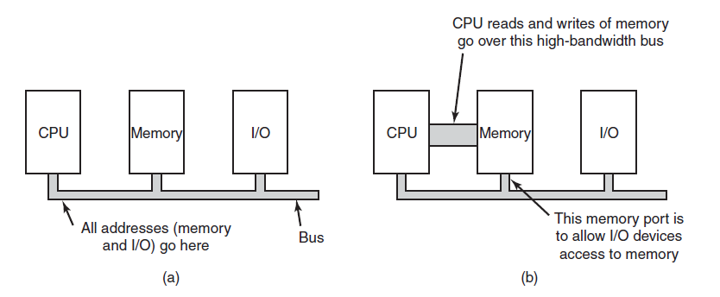

Slide 22
Direct Memory Access (DMA)
Both port and memory-mapped I/O have a significant downside – require CPU to run for every piece of data transferred
Instead, we can ask the device to do a bulk transfer to memory
This transfer goes directly from the device to RAM, so the CPU can run concurrently

Slide 23
DMA Controller
Communication between devices and RAM is mediated by the DMA controller
CPU uses programmed I/O (Port I/O or MMIO) to configure the DMA controller first
What device to transfer from, where to transfer to, how much data
DMA controller independently fetches bytes from the disk into main memory and then notifies the CPU when the transfer is complete

Slide 24
Source: Stallings
Notes:
Figure 11.2 indicates, in general terms, the DMA logic. The DMA unit is capable of
mimicking the processor and, indeed, of taking over control of the system bus just
like a processor. It needs to do this to transfer data to and from memory over the
system bus.
The DMA technique works as follows. When the processor wishes to read or
write a block of data, it issues a command to the DMA module by sending to the
DMA module the following information:
• Whether a read or write is requested, using the read or write control line
between the processor and the DMA module
• The address of the I/O device involved, communicated on the data lines
• The starting location in memory to read from or write to, communicated on
the data lines and stored by the DMA module in its address register
• The number of words to be read or written, again communicated via the data
lines and stored in the data count register
The processor then continues with other work. It has delegated this I/O operation
to the DMA module. The DMA module transfers the entire block of data, one word
at a time, directly to or from memory, without going through the processor. When the
transfer is complete, the DMA module sends an interrupt signal to the processor. Thus,
the processor is involved only at the beginning and end of the transfer (Figure C.4c).

Slide 25
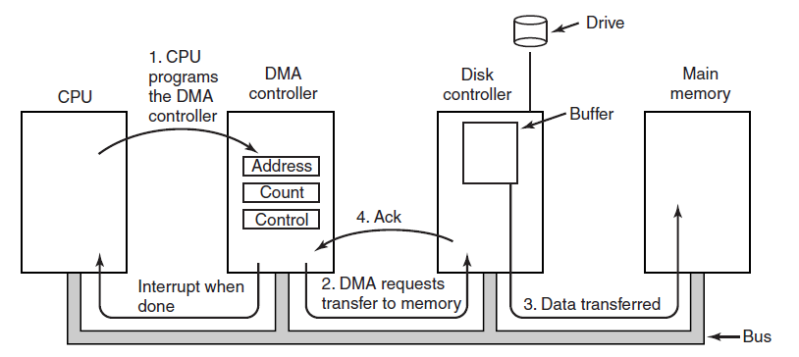
Direct Memory Access
Figure 5-4. Operation of a DMA transfer.

Slide 26
Real World DMA
Typically DMA controllers can handle more than one transfer at a time (multi-channel)
If so, note that now the DMA controller must implement something like a scheduler!
Sometimes there is not a single DMA controller, but rather individual peripherals each can do transfers directly to RAM (bus mastering)
Note that this can sometimes cause bus contention as devices can no longer coordinate transfers
Some systems support peer-to-peer DMA – direct channel between two peripheral devices

Slide 27
Interrupts
When hardware devices need attention for any reason (e.g., done with some work) they raise an interrupt
Interrupts are implemented by asserting a signal on some bus line, which is detected by the interrupt controller
Interrupt controller queues interrupts and delivers them to the CPU
CPU handles each one and then tells the interrupt controller it has acknowledged the interrupt

Slide 28
Interrupt Handling
When the CPU is notified of an interrupt, it stops whatever it's doing
At this point it needs to save some state so that it can come back to it later
The interrupt will come with a number, which is used to index into a table (the interrupt vector table) to find the address of the handler
The interrupt handler will acknowledge the interrupt, allowing the interrupt controller to deliver the next one

Slide 29
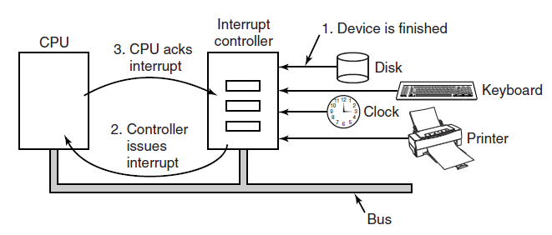
Interrupts Revisited
Figure 5-5. How an interrupt happens. The connections between the devices and the interrupt controller actually use interrupt lines on the bus rather than dedicated wires.

Slide 30
Interrupt Precision
Modern CPUs do a lot of things at once
Speculative execution, out of order processing, pipelining
When an interrupt occurs, we may have multiple partially completed instructions pending
All of that has to stop to handle the interrupt, and this may leave things in a weird, half-completed state

Slide 31
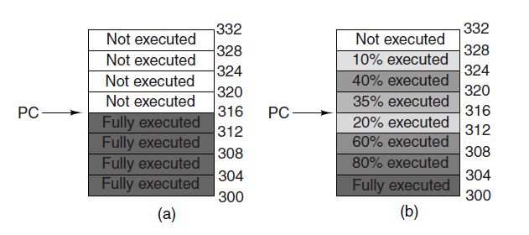
Precise vs. Imprecise
Figure 5-6. (a) A precise interrupt. (b) An imprecise interrupt.

Slide 32
Precise Interrupts
We say an interrupt is precise if:
The program counter is saved somewhere
All instructions before the program counter have finished
All instructions after the program counter have not yet started
Execution state of the instruction at program counter is known
If these are satisfied, it's easy for the OS to resume after an interrupt

Slide 33
Imprecise Interrupts
If these properties are not satisfied, the interrupt is imprecise
Typically in this case, the architecture's interrupt handling will provide lots of information about the half-completed state at every interrupt
Then it's the OS's job to roll back any partly finished instructions before resuming
Very unpleasant for the OS writer
x86 provides precise interrupts, at the cost of much greater hardware complexity

Slide 34
What are the 4 I/O Techniques used by hardware?
What are Interrupts?

Slide 35
i/o software

Slide 36
I/O – Software Side
Some high-level considerations writing software to deal with I/O:
Device independence – programs shouldn't have to care which specific device is used for input/output
Uniform naming – names for I/O resources should not be tied to a specific hardware device
Error handling – handle errors at the lowest level possible, avoid bothering the user unless necessary
Make I/O appear synchronous to the user (unless explicitly requested otherwise)
Handle resource sharing for devices that support it

Slide 37
I/O Programming Model
Three main kinds
Programmed I/O
Interrupt-driven I/O
DMA-based I/O

Slide 38
Programmed I/O
CPU does all the work
For each operation, poll the hardware, send or receive the data, and repeat until all data is sent or received
Example: reading from a serial port
void ReadDebugChar(int *c) {
// Wait until serial port has data
while (ReadDword(0xbd370404) & 0x4 == 0) {
// busy loop
}
ReadDword(0xbd370414, &c);
}
Notes:
Simple
But it ties the CPU until all work is done

Slide 39
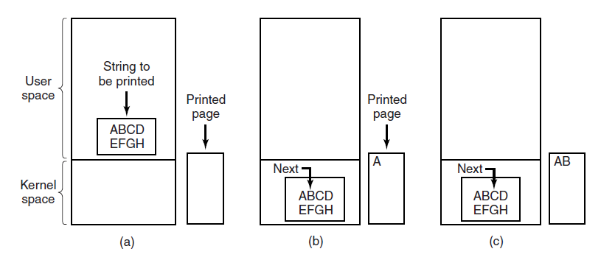
Programmed I/O (1)
Figure 5-7. Steps in printing a string.
Notes:
User space program assembles a string in a buffer. (user space)
User acquires the printer by making a system call to open it.

Slide 40
Interrupt-Driven I/O
Instead of polling while waiting for hardware to be ready, we could ask the hardware to tell us via an interrupt
Now we can go do other things while we wait for it to finish
This can make a system much more responsive if the device is slow

Slide 41
DMA I/O
This is essentially an extension of interrupt-driven I/O
Instead of interrupting every time a piece of data is ready, program DMA controller for a bulk transfer
Advantage over plain interrupt-driven access is that if your data is large, you get just one interrupt rather than many

Slide 42
I/O Techniques
Notes:
Table 11.1 indicates the relationship among these three techniques. In most
computer systems, DMA is the dominant form of transfer that must be supported
by the operating system.

Slide 43
What are the 3 different I/O Techniques used by software?
What is the problem with Programmed I/O?

Slide 44
Operating system i/o design issues

Slide 45
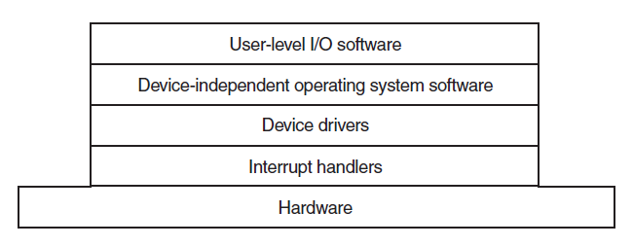
I/O handling architecture
Figure 5-11. Layers of the I/O software system.

Slide 46
I/O handling architecture
Figure 5-11. Layers of the I/O software system.

Slide 47
Interrupt Handlers
Conceptually simple – just do what's necessary to handle the interrupt and then resume execution
Reality is more complicated...

Slide 48
Interrupt Handlers
Save additional registers
Set up kernel context (e.g., load page tables or set TLB entries)
Set up a stack for the handler
Acknowledge the interrupt
Copy saved registers into the process descriptor
Run the interrupt handler
Choose next process (may be able to wake up a blocked proc)
Switch context to new process

Slide 49
Interrupt Handler Organization
If the rate of interrupts is high and we take a while to service each one, we may fall behind
To avoid this, interrupt handlers are often written to do the minimum possible work needed to acknowledge the interrupt
They then queue the remaining work to do later (with interrupts enabled)
In Linux, interrupt acknowledgement is called the top half, and the remaining work happens in the bottom half

Slide 50
I/O handling architecture

Slide 51
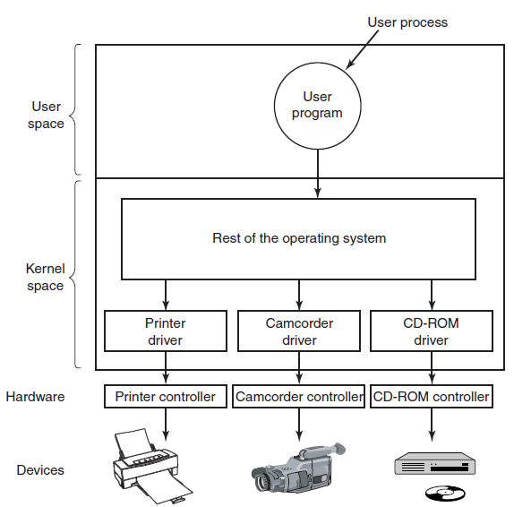
Device Drivers
Figure 5-12. Logical positioning of device drivers. In reality all communication between drivers and device controllers goes over the bus.

Slide 52
Device Drivers
Device drivers do the actual work of interacting with the device controller
Initialization – talk to the controller to get device into a working state
Control – take commands from higher levels in OS and translate them into hardware requests
Multiplexing – check whether device is in use and defer until later if so
Power management – put the device to sleep when it's not being used

Slide 53
Device Driver Considerations
Drivers may be interrupted while working, and the interrupt may call into the same driver
So drivers must be written to be reentrant –expect that it can be called again before finishing its first task
Because hardware may be hot-pluggable (e.g., USB devices), drivers may get loaded and unloaded throughout the lifetime of a system

Slide 54
Driver APIs
Because it's convenient not to write drivers for every piece of hardware yourself, OS creators typically specify a driver API
This API specifies a well-defined model for the OS to use when interacting with the driver, and says what kernel functions are available for driver use
So if your OS is popular enough, hardware manufacturers will write drivers for you!

Slide 55
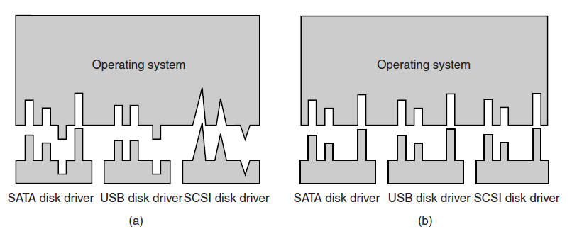
Uniform Interfacing for Device Drivers
Figure 5-14.
(a) Without a standard driver interface. (b) With a standard driver interface.

Slide 56
I/O handling architecture
Figure 5-11. Layers of the I/O software system.
Notes:
Interrupt Handlers
Device Drivers
Device Independent System Software

Slide 57
Generic I/O Layer
Above the driver level, there may be a common layer for handling I/O issues common to multiple drivers
Buffering I/O requests
Generalized error reporting
Provide uniform block size

Slide 58
Name the layers of the I/O Architecture.
Notes:
Interrupt Handlers
Device Drivers
Device Independent System Software

Slide 59
i/o Buffering

Slide 60
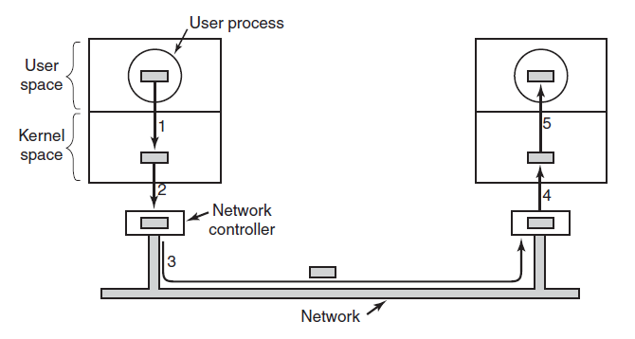
Buffering example
Figure 5-16. Networking may involve many copies of a packet.

Slide 61
Buffering
For efficiency, we don't want to give data back to a process in small pieces
So we should store it up in some buffer until enough has accumulated

Slide 62
Buffering
Where do we store the buffer?
In user space? No – might have to swap out user page, but I/O has to go somewhere
In kernel space? Better – but now what happens when the kernel needs to copy things to the user, but data is still coming in?
In kernel space with two buffers – double buffering

Slide 63
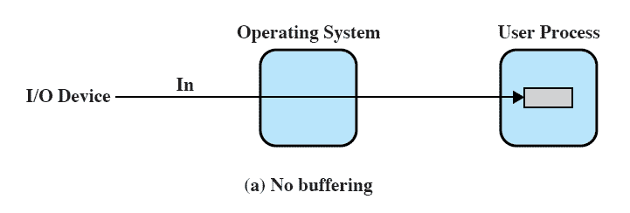
No Buffer
Without a buffer, the OS directly accesses the device when it needs
Notes:
Without a buffer, the OS directly accesses the device when it needs to.

Slide 64
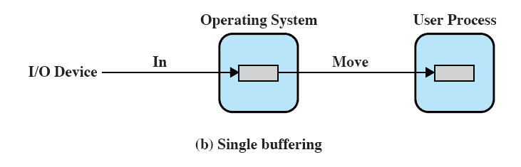
Single Buffer
Operating system assigns a buffer in main memory for an I/O request
Notes:
The simplest type of support that the operating system can provide is single buffering
( Figure 11.5b ). When a user process issues an I/O request, the OS assigns a buffer in
the system portion of main memory to the operation.
In the case of line-at-a-time I/O, the buffer can be used to hold a single line.
The user process is suspended during input, awaiting the arrival of the entire line.
For output, the user process can place a line of output in the buffer and continue
processing. It need not be suspended unless it has a second line of output to send
before the buffer is emptied from the first output operation. In the case of byte-at-a-time
I/O, the interaction between the OS and the user process follows the producer/
consumer model discussed in Chapter 5 .

Slide 65
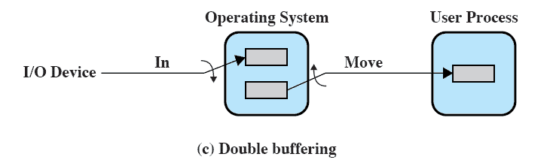
Double Buffer
Use two system buffers instead of one
A process can transfer data to or from one buffer while the operating system empties or fills the other buffer
Also known as buffer swapping
Notes:
An improvement over single buffering can be had by assigning two system buffers to
the operation ( Figure 11.5c ). A process now transfers data to (or from) one buffer
while the operating system empties (or fills) the other. This technique is known as
double buffering or buffer swapping .
For block-oriented transfer, we can roughly estimate the execution time as
max [ C , T ]. It is therefore possible to keep the block-oriented device going at full
speed if C … T . On the other hand, if C 7 T , double buffering ensures that the
process will not have to wait on I/O. In either case, an improvement over single
buffering is achieved. Again, this improvement comes at the cost of increased
complexity.
For stream-oriented input, we again are faced with the two alternative modes
of operation. For line-at-a-time I/O, the user process need not be suspended for
input or output, unless the process runs ahead of the double buffers. For byte-at-atime
operation, the double buffer offers no particular advantage over a single buffer
of twice the length. In both cases, the producer/consumer model is followed.

Slide 66
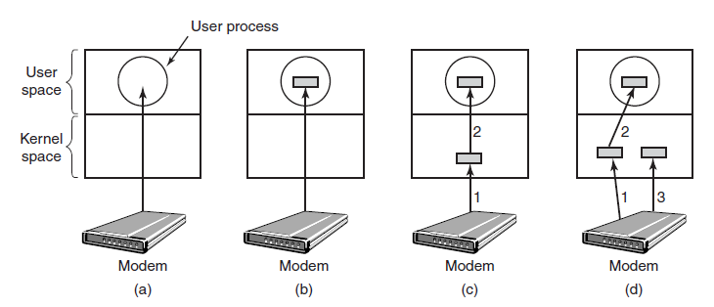
Buffering (1)
Unbuffered input.
Buffering in user space.
Buffering in the kernel followed by copying to user space.
Double buffering in the kernel.

Slide 67
Circular / Ring Buffer
A popular data structure for buffering I/O is the circular (or ring) buffer
Keep a buffer and two pointers
One to the first free slot in the buffer; can write there and advance the pointer
One to the first unprocessed item in the buffer; can read from there and advance the pointer
When either pointer reaches the end of the buffer, wrap around to the start

Slide 68
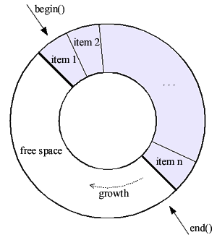
Image by Jan Gaspar, The Boost Book

Slide 69
Buffering Performance
If there are too many layers of buffering between the hardware and the user program, performance suffers
Some operating systems try to minimize the number of copy operations ("Zero-copy I/O"), or number of user/kernel transitions
Example: sendfile API, which copies data between two file descriptors
Because descriptors are used, both src and dest are in the kernel and we can avoid copying to/from user land
Windows has similar TransmitFile

Slide 70
Why do we want to user double buffering?
Notes:
Interrupt Handlers
Device Drivers
Device Independent System Software

Slide 71
Xv6 i/o case studies

Slide 72
keyboard

Slide 73
Keyboards
Each keypress generates an interrupt
Information about which key it was can be read out using port I/O
Notes:
One character at a time
One for the key dow and one for the key up

Slide 74
xv6 Keyboard Init
void
consoleinit(void)
{
initlock(&cons.lock, "console");
initlock(&input.lock, "input");
devsw[CONSOLE].write = consolewrite;
devsw[CONSOLE].read = consoleread;
cons.locking = 1;
picenable(IRQ_KBD);
ioapicenable(IRQ_KBD, 0);
}
Notes:
Most of them have an init function which we see here.
Process interrupt controller enable
picenable(IRQ_KBD);
Advanced process interrupt controller.
ioapicenable(IRQ_KBD, 0);

Slide 75
Reading One Character
int
kbdgetc(void)
{
static uint shift;
static uchar *charcode[4] = {
normalmap, shiftmap, ctlmap, ctlmap
};
uint st, data, c;
st = inb(KBSTATP);
if((st & KBS_DIB) == 0)
return -1;
data = inb(KBDATAP);
if(data == 0xE0){
shift |= E0ESC;
return 0;
} else if(data & 0x80){
// Key released
data = (shift & E0ESC ? data : data & 0x7F);
shift &= ~(shiftcode[data] | E0ESC);
return 0;
} else if(shift & E0ESC){
// Last character was an E0 escape; or with 0x80
data |= 0x80;
shift &= ~E0ESC;
}
shift |= shiftcode[data];
shift ^= togglecode[data];
c = charcode[shift & (CTL | SHIFT)][data];
if(shift & CAPSLOCK){
if('a' <= c && c <= 'z')
c += 'A' - 'a';
else if('A' <= c && c <= 'Z')
c += 'a' - 'A';
}
return c;
}
Notes:
You are getting scan codes from the keyboard so that the keyboard controller can support diferent languages
Then convert those scan codes to asci values
Inb tells us if theres a key waiting for us
Shift we set a flag and you can see we check whether ctl or shift is set

Slide 76
Scan Codes
static uchar normalmap[256] =
{
NO, 0x1B, '1', '2', '3', '4', '5', '6', // 0x00
'7', '8', '9', '0', '-', '=', '\b', '\t',
'q', 'w', 'e', 'r', 't', 'y', 'u', 'i', // 0x10
'o', 'p', '[', ']', '\n', NO, 'a', 's',
'd', 'f', 'g', 'h', 'j', 'k', 'l', ';', // 0x20
'\'', '`', NO, '\\', 'z', 'x', 'c', 'v',
'b', 'n', 'm', ',', '.', '/', NO, '*', // 0x30
NO, ' ', NO, NO, NO, NO, NO, NO,
NO, NO, NO, NO, NO, NO, NO, '7', // 0x40
'8', '9', '-', '4', '5', '6', '+', '1',
'2', '3', '0', '.', NO, NO, NO, NO, // 0x50
[0x9C] '\n', // KP_Enter
[0xB5] '/', // KP_Div
[0xC8] KEY_UP, [0xD0] KEY_DN,
[0xC9] KEY_PGUP, [0xD1] KEY_PGDN,
[0xCB] KEY_LF, [0xCD] KEY_RT,
[0x97] KEY_HOME, [0xCF] KEY_END,
[0xD2] KEY_INS, [0xD3] KEY_DEL
};
Values returned by the keyboard are not ASCII, so we need a mapping table
Notes:
Scan codes is an array that maps from it’s entry to it’s asci value
No there’s nothing there.

Slide 77
Console Interrupt
void
consoleintr(int (*getc)(void))
{
int c, doprocdump = 0;
acquire(&cons.lock);
while((c = getc()) >= 0){
switch(c){
case C('P'): // Process listing.
doprocdump = 1; // procdump() locks cons.lock indirectly; invoke later
break;
case C('U'): // Kill line.
while(input.e != input.w &&
input.buf[(input.e-1) % INPUT_BUF] != '\n'){
input.e--;
consputc(BACKSPACE);
}
break;
case C('H'): case '\x7f': // Backspace
if(input.e != input.w){
input.e--;
consputc(BACKSPACE);
}
break;
default:
if(c != 0 && input.e-input.r < INPUT_BUF){
c = (c == '\r') ? '\n' : c;
input.buf[input.e++ % INPUT_BUF] = c;
consputc(c);
if(c == '\n' || c == C('D') || input.e == input.r+INPUT_BUF){
input.w = input.e;
wakeup(&input.r);
}
}
break;
}
}
release(&cons.lock);
if(doprocdump) {
procdump(); // now call procdump() wo. cons.lock held
}
}
void
kbdintr(void)
{
consoleintr(kbdgetc);
}
void
trap(struct trapframe *tf)
{
...
case T_IRQ0 + IRQ_KBD:
kbdintr();
lapiceoi();
break;
...
}
Notes:
Trap is the function that gets called whenever there’s a CPU exception, a hardware interrupt or a software interrupt.
IN this case we check wether it’s a keyboard interrupt and if it is,
We will tell the interrupt controller we have ack the interrupt.
Kbdintr calls a generic interrupt handler,
There is 2 ways of getting keyboard data,
The keyboard and also a serial port.
Control P for the process listing.
Control U for killing a line.

Slide 78
Keyboard Interrupt Handling
Keys are buffered until a full line is entered in a circular buffer
When the user presses enter, we wake up any process waiting for keyboard input (saw this previously)
#define INPUT_BUF 128
struct {
struct spinlock lock;
char buf[INPUT_BUF];
uint r; // Read index
uint w; // Write index
uint e; // Edit index
} input;
Notes:
Edit index if you delete a character.

Slide 79
Disk drive

Slide 80
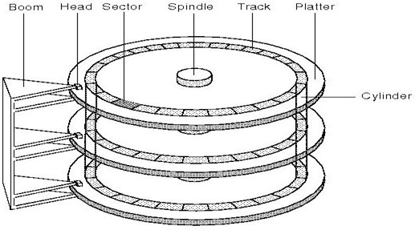
Disks
Basic terminology:
Head
Track
Cylinder
Sector
Notes:
Track is a ring on the platter
Cylinder, select which of these platters we are reading from

Slide 81
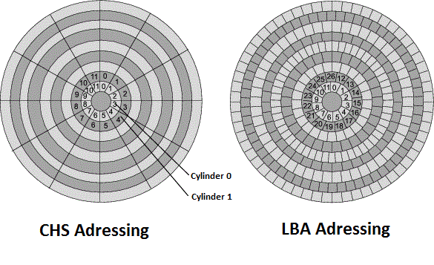
Disks - Addressing
Cylinder/Head/Sector is cumbersome to use
Easier to just have a linear addressing scheme –this is called Logical Block Addressing (LBA)
Notes:
Starts at the innermost that 0 and then it continues forward.

Slide 82
Disk Protocols
IDE – introduced 1986, max transfer 100MB/s (original drives – ~16MB/s)
SCSI – introduced in 1981, still in use today
SATA – introduced 2003, major consumer standard in use now, up to 16 Gb/s
Notes:
IDE: Integrated Drive electronics
SATA: Serial advanced technology attachment
SCSI – Small computer system

Slide 83
xv6 IDE Driver
Implemented in ide.c
Implements an Interrupt-Driven I/O IDE driver (no DMA)
Maintains a queue of disk blocks that need to be read or written
A higher layer, in bio.c, handles caching blocks in memory using LRU algorithm
Notes:
LRU – fixed size buffer.
Buffers that have been least recentrly used will be evicted

Slide 84
IDE Initialization
Talk to interrupt controller to enable interrupts for the IDE controller
Wait for the drive to become ready
Poll for a second hard drive
Set the current drive to the first disk
void
ideinit(void)
{
int i;
initlock(&idelock, "ide");
picenable(IRQ_IDE);
ioapicenable(IRQ_IDE, ncpu - 1);
idewait(0);
// Check if disk 1 is present
outb(0x1f6, 0xe0 | (1<<4));
for(i=0; i<1000; i++){
if(inb(0x1f7) != 0){
havedisk1 = 1;
break;
}
}
// Switch back to disk 0.
outb(0x1f6, 0xe0 | (0<<4));
}
Notes:
Again we will have Initialization
Interrupt handler.

Slide 85
Sending Commands
// Start the request for b. Caller must hold idelock.
static void
idestart(struct buf *b)
{
if(b == 0)
panic("idestart");
if(b->blockno >= FSSIZE)
panic("incorrect blockno");
int sector_per_block = BSIZE/SECTOR_SIZE;
int sector = b->blockno * sector_per_block;
if (sector_per_block > 7) panic("idestart");
idewait(0);
outb(0x3f6, 0); // generate interrupt
outb(0x1f2, sector_per_block); // number of sectors
outb(0x1f3, sector & 0xff);
outb(0x1f4, (sector >> 8) & 0xff);
outb(0x1f5, (sector >> 16) & 0xff);
outb(0x1f6, 0xe0 | ((b->dev&1)<<4) | ((sector>>24)&0x0f));
if(b->flags & B_DIRTY){
outb(0x1f7, IDE_CMD_WRITE);
outsl(0x1f0, b->data, BSIZE/4);
} else {
outb(0x1f7, IDE_CMD_READ);
}
}
Data written using out instruction
Notes:
Block size might be different on each layer
We do the translation here.
Interrupt driven I/O not interrupt driven.
Trhougput is lower

Slide 86
Interrupt Handling
void
trap(struct trapframe *tf)
{
[...]
case T_IRQ0 + IRQ_IDE:
ideintr();
lapiceoi();
break;
[...]
}
Call main IDE interrupt handler
Acknowledge
interrupt complete

Slide 87
Interrupt Handling
// Interrupt handler.
void
ideintr(void)
{
struct buf *b;
// First queued buffer is the active request.
acquire(&idelock);
if((b = idequeue) == 0){
release(&idelock);
// cprintf("spurious IDE interrupt\n");
return;
}
idequeue = b->qnext;
// Read data if needed.
if(!(b->flags & B_DIRTY) && idewait(1) >= 0)
insl(0x1f0, b->data, BSIZE/4);
// Wake process waiting for this buf.
b->flags |= B_VALID;
b->flags &= ~B_DIRTY;
wakeup(b);
// Start disk on next buf in queue.
if(idequeue != 0)
idestart(idequeue);
release(&idelock);
}
Data actually read using in instruction
Inside each interrupt we kick off the next read/write

Slide 88
timers

Slide 89
Timers
Timers keep the OS running – we have seen how they allow preemptive scheduling to work
Generally, implemented in hardware using a quartz crystal oscillator
Can be programmed for periodic interrupts or one-shot (fire once and then disable)

Slide 90
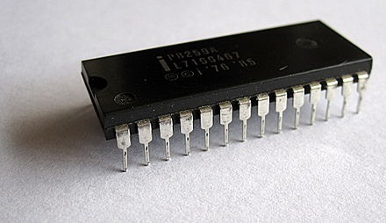
xv6 Timer
In uniprocessor mode: xv6 uses the Intel 8253/8254/82C54 Programmable Interval Timer (PIT)
In SMP mode: APIC timer

Slide 91
Intel 8253 PIT
Intel timer: oscillates at a standard 1193182 Hz
You program it by setting the frequency divider, which controls how often you get interrupted
Internally, sets a 16-bit counter that counts down every cycle

Slide 92
#define IO_TIMER1 0x040 // 8253 Timer #1
// Frequency of all three count-down timers;
// (TIMER_FREQ/freq) is the appropriate count
// to generate a frequency of freq Hz.
#define TIMER_FREQ 1193182
#define TIMER_DIV(x) ((TIMER_FREQ+(x)/2)/(x))
#define TIMER_MODE (IO_TIMER1 + 3) // timer mode port
#define TIMER_SEL0 0x00 // select counter 0
#define TIMER_RATEGEN 0x04 // mode 2, rate generator
#define TIMER_16BIT 0x30 // r/w counter 16 bits, LSB first
void
timerinit(void)
{
// Interrupt 100 times/sec.
outb(TIMER_MODE, TIMER_SEL0 | TIMER_RATEGEN | TIMER_16BIT);
outb(IO_TIMER1, TIMER_DIV(100) % 256);
outb(IO_TIMER1, TIMER_DIV(100) / 256);
picenable(IRQ_TIMER);
}

Slide 93
APIC Timer
The APIC is the newer interrupt controller meant for multiprocessor systems; it includes a timer
Each CPU has an independent timer and receives its own interrupts
Rather than oscillating at a predetermined frequency, it uses the CPU's native bus frequency
This varies from CPU to CPU
If you want to know exactly how fast it's ticking, you have to calibrate against the PIT or CMOS clock

Slide 94
volatile uint *lapic;
static void
lapicw(int index, int value)
{
lapic[index] = value;
lapic[ID]; // wait for write to finish, by reading
}
void
lapicinit(void)
{
[...]
// The timer repeatedly counts down at bus frequency
// from lapic[TICR] and then issues an interrupt.
// If xv6 cared more about precise timekeeping,
// TICR would be calibrated using an external time source.
lapicw(TDCR, X1);
lapicw(TIMER, PERIODIC | (T_IRQ0 + IRQ_TIMER));
lapicw(TICR, 10000000);
[...]
}
Note: memory-mapped I/O

Slide 95
Timer Interrupt Handling
void
trap(struct trapframe *tf)
{
[...]
switch(tf->trapno){
case T_IRQ0 + IRQ_TIMER:
if(cpu->id == 0){
acquire(&tickslock);
ticks++;
wakeup(&ticks);
release(&tickslock);
}
lapiceoi();
break;
[...]
// Force process to give up CPU on clock tick.
// If interrupts were on while locks held, would need to check nlock.
if(proc && proc->state == RUNNING && tf->trapno == T_IRQ0+IRQ_TIMER)
yield();
[...]
}
Notes:
User Spaced programs can call GetTicks()
Yield which goes into the scheduler.

Slide 96
Still Plenty More Hardware
To have a functional OS, we still need more hardware support:
Graphics (at least text console graphics) – cgaputc() in console.c
Serial port – uart.c
The other parts of the APIC (to route interrupts to the correct CPU) – mp.c, lapic.c, ioapic.c
If you're curious, feel free to read up on how they're implemented

